Slide 1
Feature Extraction and Price Prediction using Machine Learning
Project 4
Submitted TO - NextHikes IT Solutions
Submitted By- RAJBIR KAUR

Slide 2
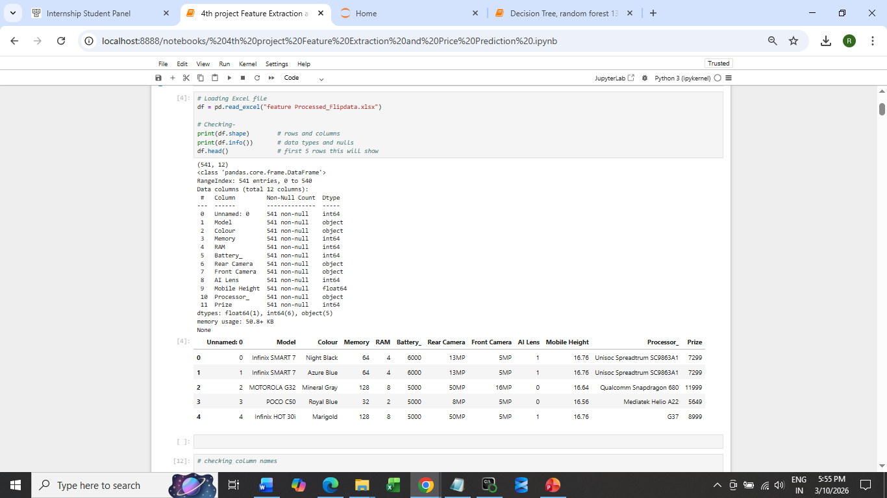
Data Loaded

Slide 3
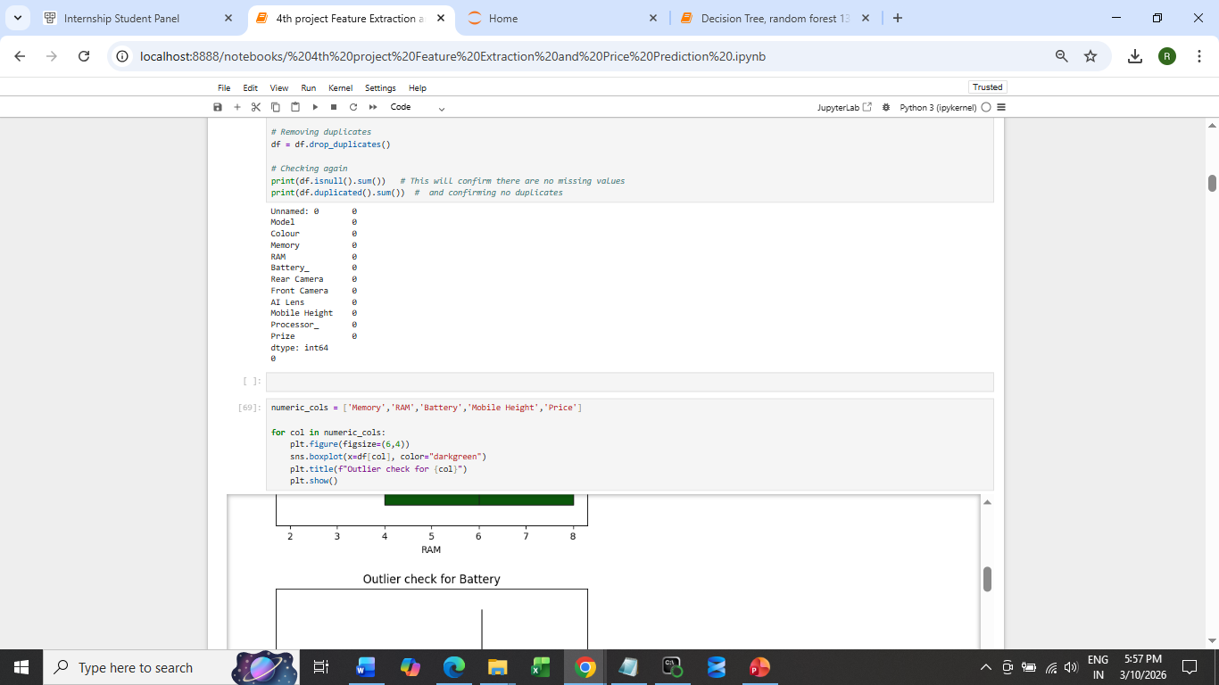
Data Preprocessing Handling missing values, duplicated, outlier

Slide 4
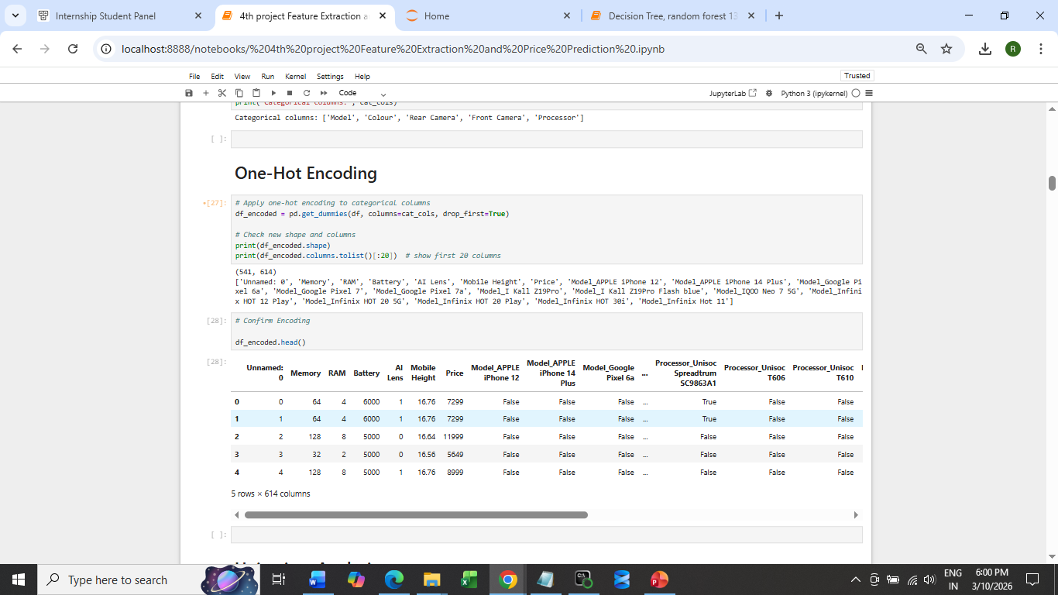
One-Hot Encoding

Slide 5
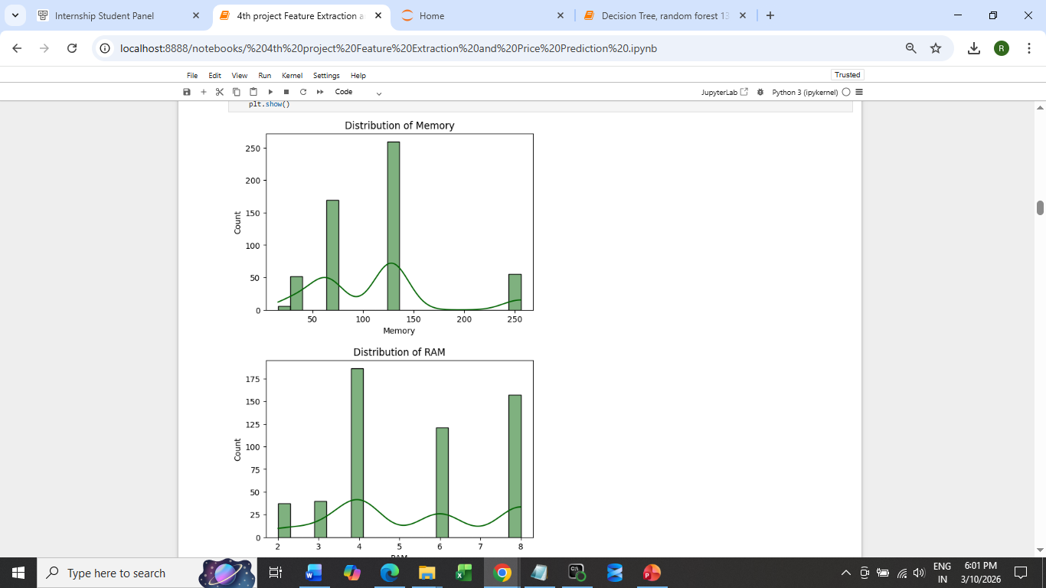
Exploratory Analysis (Bivariate & multivariate analysis highlights)

Slide 6
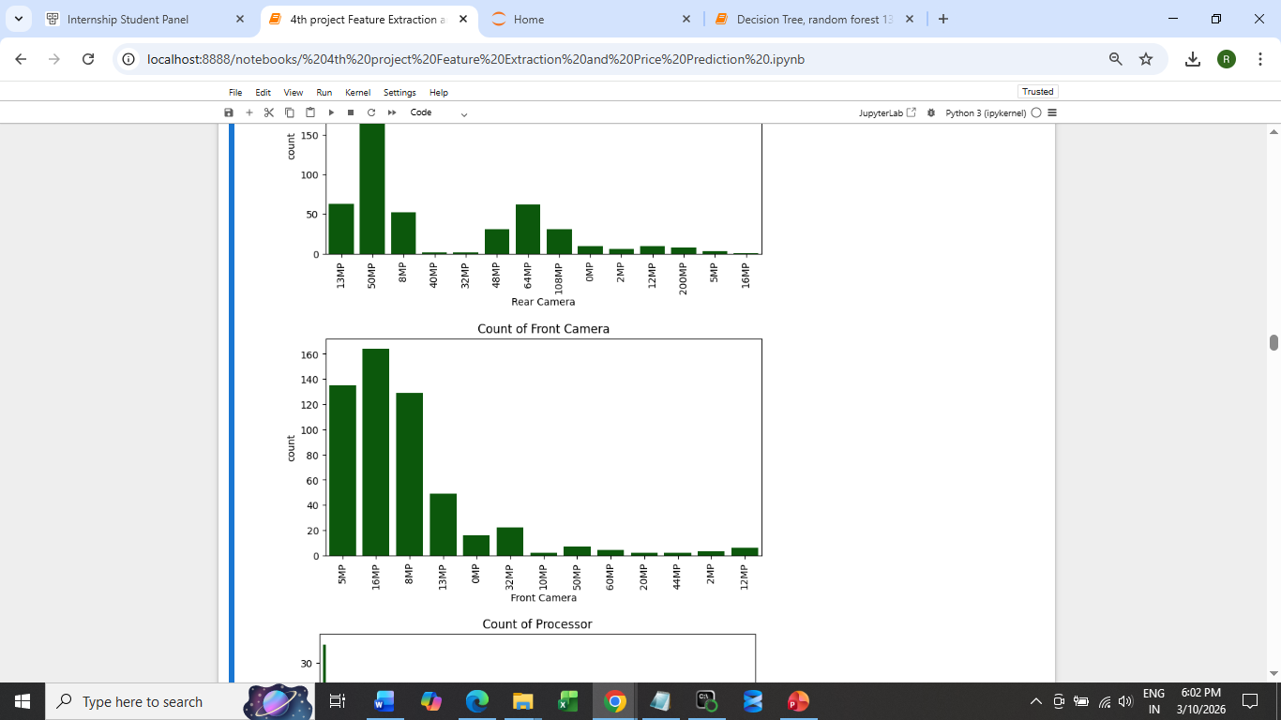

Slide 7
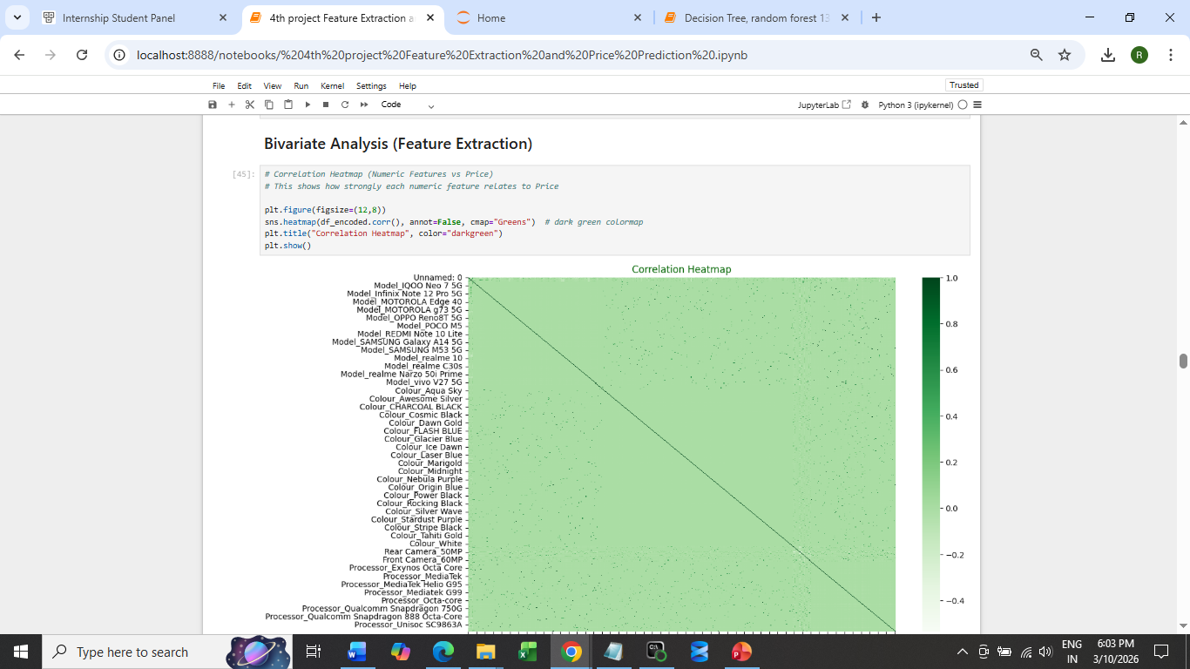
Bivariate Analysis

Slide 8
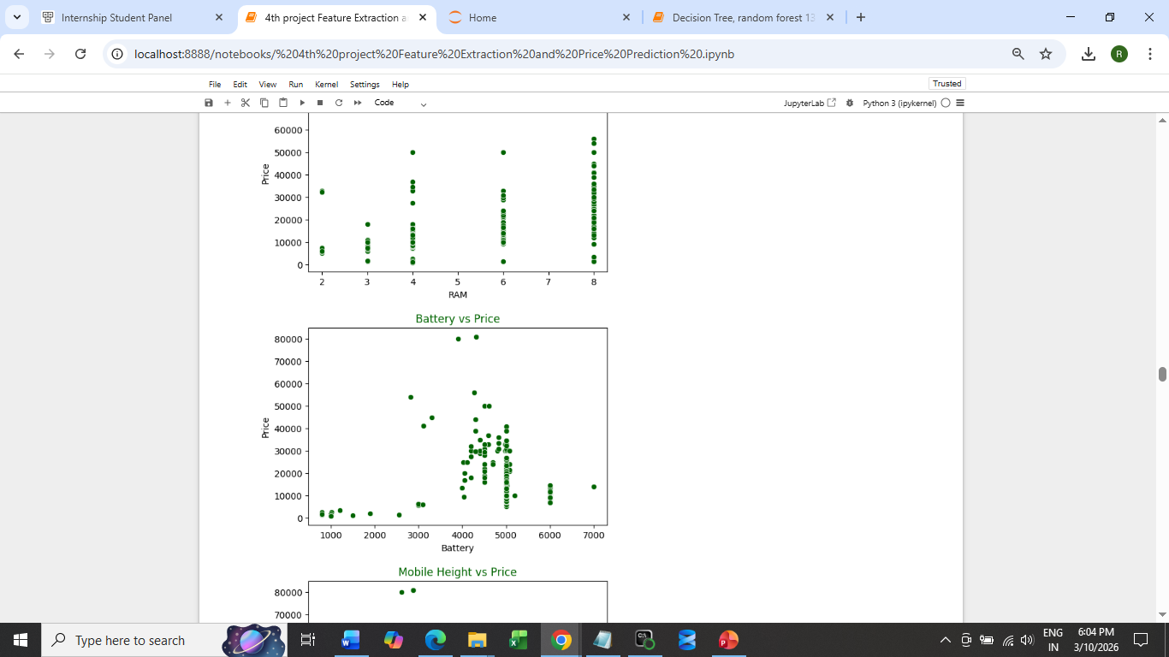

Slide 9
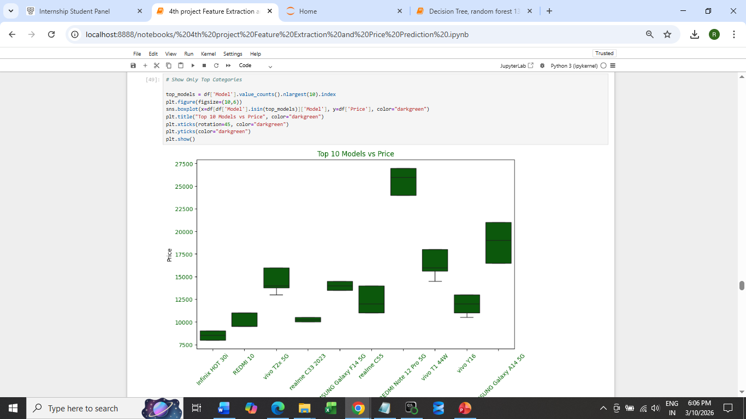

Slide 10
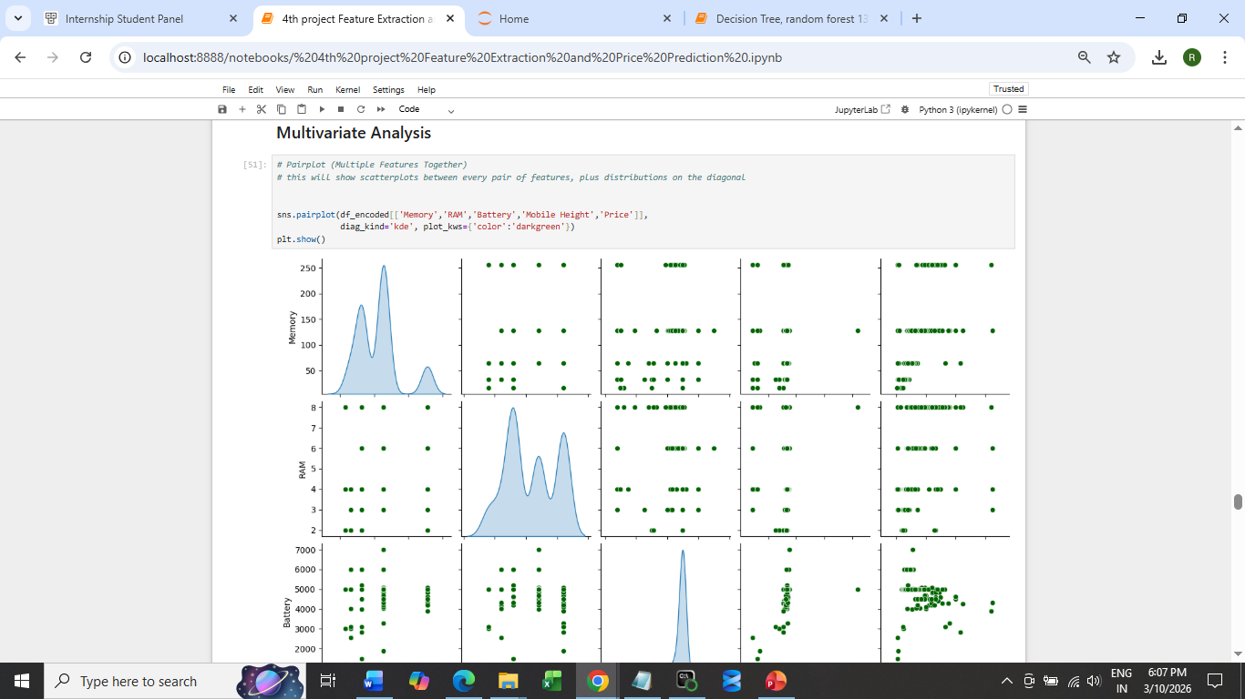
Multivariate Analysis

Slide 11
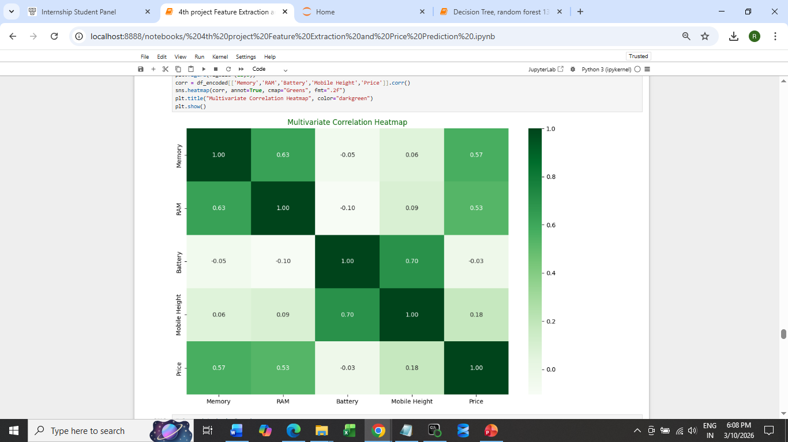
Heatmap

Slide 12
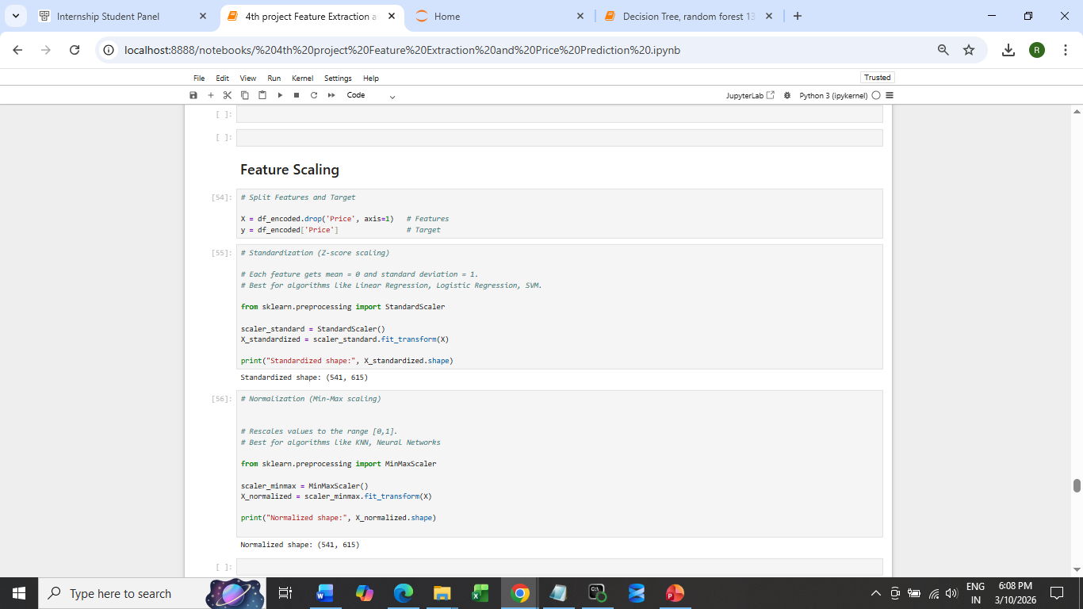
Feature Scaling

Slide 13
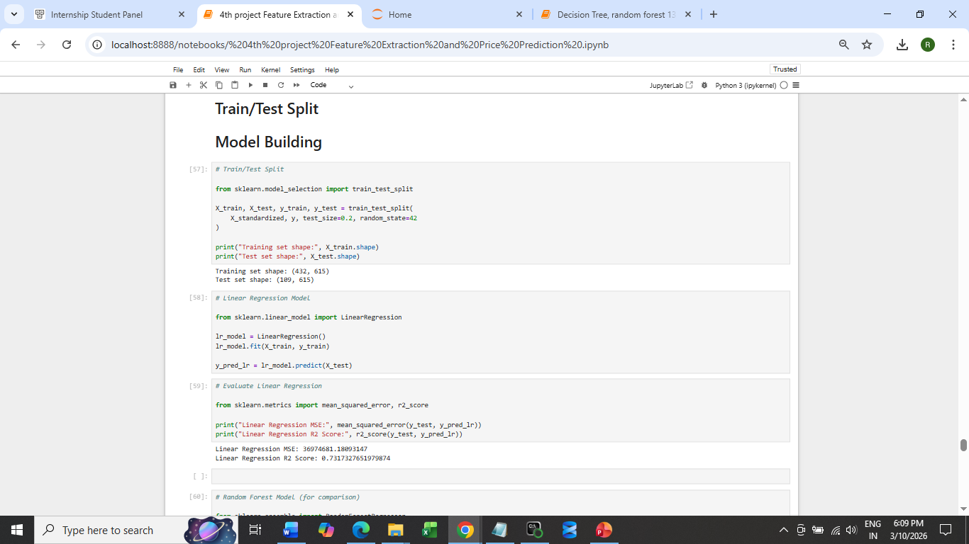
Train/Test – model building

Slide 14
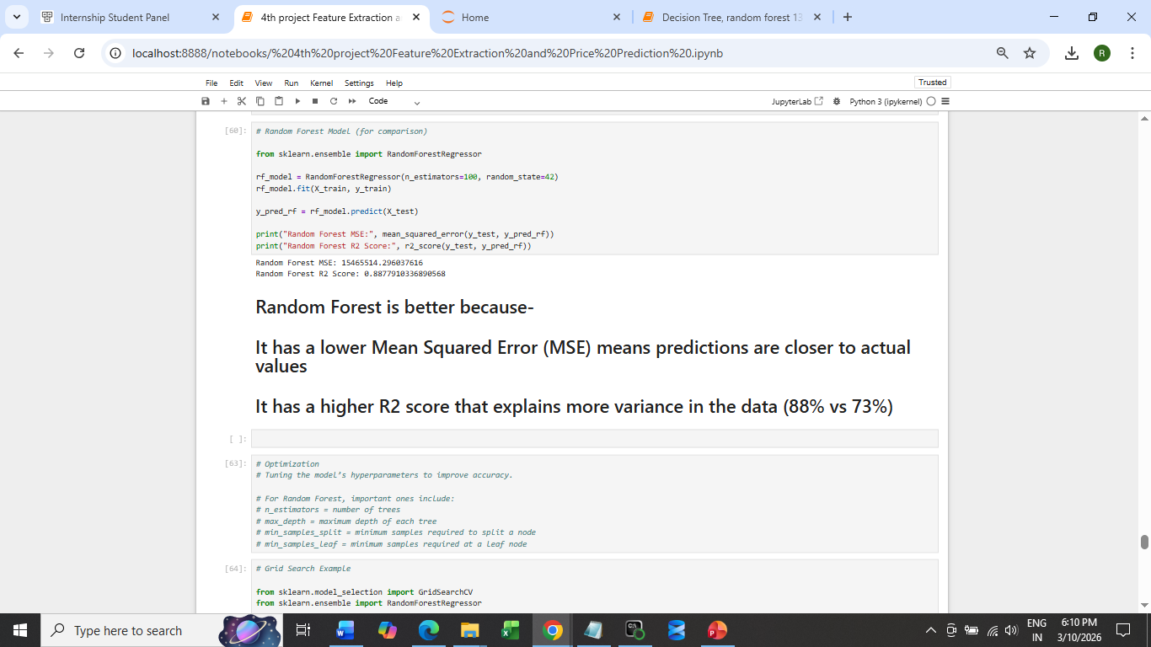
Random Forest MSE: 15465514.296037616 Random Forest R2 Score: 0.8877910336890568

Slide 15
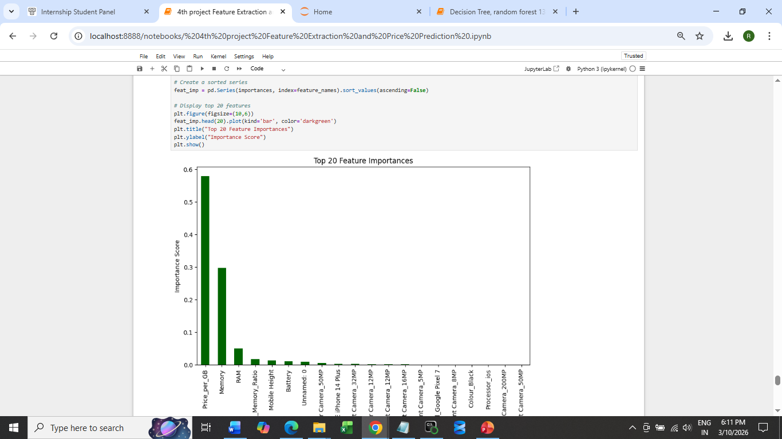
Feature Importance

Slide 16
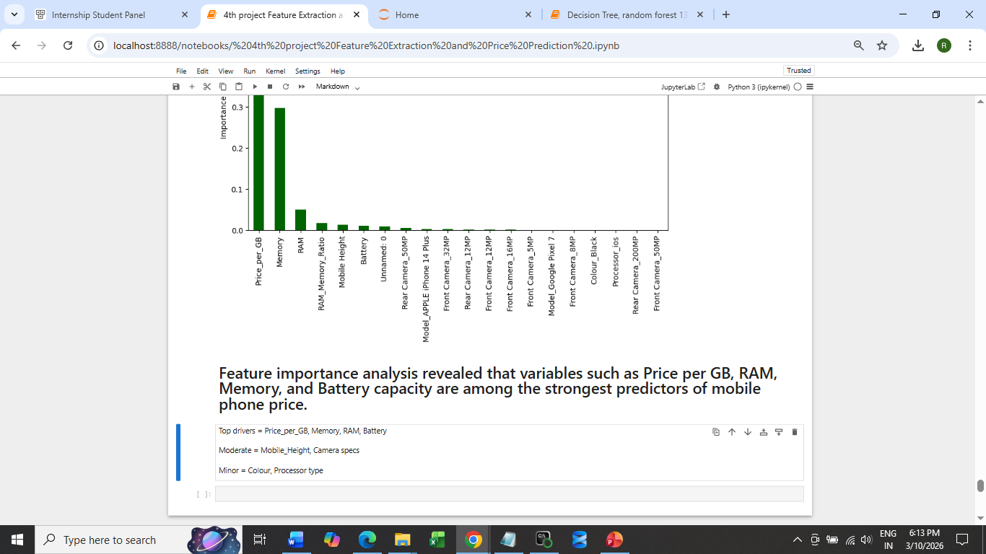
Top drivers = Price_per_GB, Memory, RAM, Battery Moderate = Mobile_Height, Camera specs Minor = Color, Processor type

Slide 17
References
Google
You tube
GridSearch

Slide 18
Thank You

